Slide 1
Computer Organization and Design Memories and State Machines
Montek Singh
Apr 11-13, 2016
Lecture 13

Slide 2
Topics
Memory Arrays
Transparent Latches
Edge-triggered Registers
Finite State Machines

Slide 3
Memory as a Lookup Table
A
B
MUX
Logic
Fn(A,B)
A multiplexer to implement a lookup table:
Remember that, in theory, we can build any 1-output combinational logic block with multiplexers
For an N-input function we need a 2^{N} input multiplexer
BIG Multiplexers?
How about 10-input function? 20-input?
Notes:
For N-input function, need
N select inputs to MUX
2**N data inputs to MUX (LOTSA pins!)
Practical TABLE LOOKUP needs more efficient
use of space...
2^{n}
1024-input MUX???

Slide 4
A Mux’s Guts
Decoder
Selector
I
Multiplexers can be partitioned into two sections.
A DECODER that identifies the desired input,and
a SELECTOR that enables that input onto the output.
0
0
A
0
B
I
0
A decoder generates all possible product terms for a set of inputs
1
A
1
B
Y
I
1
0
A
2
B
I
1
1
A
3
B
Hmmm, by sharing the decoder part of the logic MUXs could be adapted to make lookup tables with any number of outputs
Notes:
... THIS one AIN’T!
One of the four outputs is true

Slide 5
A New Combinational Device
D₁
DECODER:
k SELECT inputs,
N = 2^{k} DATA OUTPUTs.
Selected D_{j} HIGH; all others LOW.
D₂
D_{N}
k
NOW, we are well on our way to building a general purpose table-lookup device.
We can build a 2-dimensional ARRAY of decoders and selectors as follows ...
Notes:
DECODER -- sorta inverse MUX.
BINARY number as input
UNARY (decoded) output.

Slide 6
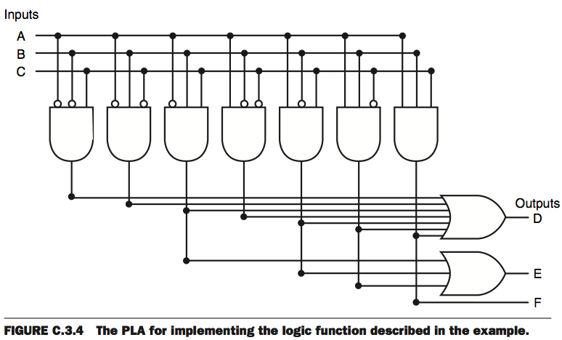
Shared Decoding Logic
We can build a general purpose “table-lookup” device called a Read-Only Memory (ROM), from which we can implement any truth table and, thus, any combinational device

Slide 7
Logic According to ROMs
ROMs ignore the structure of combinational functions ...
Size, layout, and design are independent of function
Any Truth table can be “programmed” by minor reconfiguration:
Metal layer (masked ROMs)
Fuses (Field-programmable PROMs)
Charge on floating gates (EPROMs)
... etc.
Model: LOOK UP value of function in truth table...
Inputs: “ADDRESS” of a truth table entry
ROM SIZE = # truth table entries...
... for an N-input boolean function, size = __________
2^{N} x #outputs
Notes:
2-D: 2x/dimension
NOT OPTIMAL -- Optimized for WORST case
(NO structure in TT entries!)
ADVANTAGE: Flexibility.
CHANGE function with little change in HW.

Slide 8
Analog Storage: Using Capacitors
We’ve chosen to encode information using voltages and we know from physics that we can “store” a voltage as “charge” on a capacitor
word
line
N-channel
FET serves
as an access switch
Pros:
compact!
Cons:
it leaks!  refresh
complex interface
reading a bit, destroys it
(you have to rewrite the value after each read)
it’s NOT a digital circuit
bit line
V_{REF}
To write:
Drive bit line, turn on access fet, force storage cap to new voltage To read: precharge bit line, turn on access fet,
detect (small) change in bit line voltage
This storage circuit is the basis for commodity DRAMs

Slide 9
A “Digital” Storage Element
It’s also easy to build a DIGITAL storage element (called a latch) using a MUX and FEEDBACK:
Here’s a feedback path, so it’s no longer a combinational circuit.
“state” signal
appears as both
input and output
A
G
0
0
1
1
D
--
--
0
1
Q_{IN}
0
1
--
--
Q_{OUT}
0
1
0
1
0
Q
Y
D
Q stable
B
1
Q follows D
G
S

Slide 10
Looking Under the Covers
Let’s take a quick look at the equivalent circuit for our MUX when the control is LOW (the feedback path is active)
0
Q
Q
D
G=0
1
D
G=0
1
Q
1
Advantages: 1) Maintains remembered state for as long as power is applied. 2) State is DIGITAL
Disadvantage:
1) Requires more transistors
This storage circuit is the basis for commodity SRAMs

Slide 11
Why Does Feedback = Storage?
Key Idea: use positive feedback to maintain storage indefinitely
logic gates are built to restore marginal signal levels, so noise shouldn’t be a problem!
Result: a “bi-stable” storage element
V_{IN}
V_{OUT}

Slide 12
Static D Latch
D
Q
D
Q
G
G
Positive latch
Negative latch
Q follows D
D
1
G
D
Q
0
Q
G
Q stable
“static” means latch will hold data (i.e., value of Q) while G is inactive, however long that may be.

Slide 13
Latch Timing
Circuits with memory must follow some rules
Guarantee that inputs to sequential devices are valid and stable during periods when they may influence state changes
This is assured with additional timing specifications
>t_{PULSE}
G
D
>t_{SETUP}
>t_{HOLD}
t_{PULSE} (minimum pulse width): guarantee G is active for long enough for latch to capture data
t_{SETUP} (setup time): guarantee that D value has propagated through feedback path before latch becomes opaque
t_{HOLD} (hold time): guarantee latch is opaque and Q is stable before allowing D to change again
Notes:
Data should not be changing while the latch is closing, timing matters
Think of it as a long hallway, do not want data to leak or touch

Slide 14
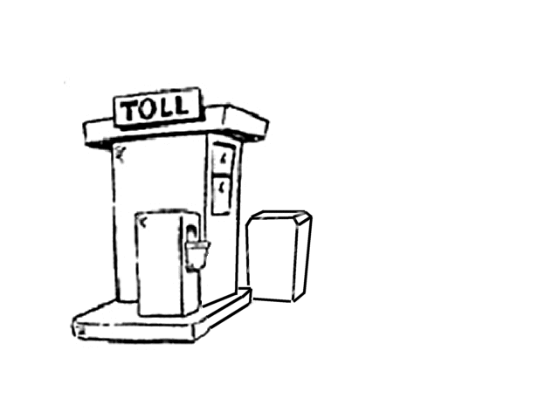




Flakey Control Systems
Here’s a strategy for saving 2 bucks the next time you find yourself at a toll booth!
Notes:
“having a door to pace the movement of data through a system is not enough”

Slide 15

Flakey Control Systems
Here’s a strategy for saving 2 bucks the next time you find yourself at a toll booth!

Slide 16
Flakey Control Systems
Here’s a strategy for saving 2 bucks the next time you find yourself at a toll booth!
WARNING:
Professional Drivers Used!
DON’T try this
At home!

Slide 17
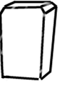
Escapement Strategy
The Solution:
Add two gates and only open one at a time.

Slide 18
Escapement Strategy
The Solution:
Add two gates and only open one at a time.

Slide 19
Escapement Strategy
The Solution:
Add two gates and only open one at a time.

Slide 20
Escapement Strategy
The Solution:
Add two gates and only open one at a time.
(Psst… Don’t tell the toll folks)

Slide 21
Escapement Strategy
The Solution:
Add two gates and only open one at a time.
(Psst… Don’t tell the toll folks)

Slide 22
Escapement Strategy
The Solution:
Add two gates and only open one at a time.
(Psst… Don’t tell the toll folks)

Slide 23
Escapement Strategy
The Solution:
Add two gates and only open one at a time.
(Psst… Don’t tell the toll folks)

Slide 24
Escapement Strategy
The Solution:
Add two gates and only open one at a time.

Slide 25
Escapement Strategy
The Solution:
Add two gates and only open one at a time.

Slide 26
Escapement Strategy
The Solution:
Add two gates and only open one at a time.
(Psst… Don’t tell the toll folks)

Slide 27
Escapement Strategy
The Solution:
Add two gates and only open one at a time.
(Psst… Don’t tell the toll folks)

Slide 28
Escapement Strategy
The Solution:
Add two gates and only open one at a time.
(Psst… Don’t tell the toll folks)

Slide 29
Escapement Strategy
The Solution:
Add two gates and only open one at a time.
(Psst… Don’t tell the toll folks)

Slide 30
Escapement Strategy
The Solution:
Add two gates and only open one at a time.

Slide 31
Escapement Strategy
The Solution:
Add two gates and only open one at a time.

Slide 32
Escapement Strategy
The Solution:
Add two gates and only open one at a time.
(Psst… Don’t tell the toll folks)
Key Idea: At no time is there an open path through both gates…

Slide 33
Edge-triggered Flip Flop
D
D
Q
D
Q
Q
D
D
Q
Q
master
slave
G
G
CLK
CLK
Logical “escapement”:
Double-gated toll booth built using logic gates
Observations:
only one latch “transparent” at any time:
master closed when slave is open (CLK is high)
slave closed when master is open (CLK is low)
no combinational path all the way through flip flop
Q only changes shortly after 0 →1 transition of CLK, so flip flop appears to be “triggered” by rising edge of CLK
Transitions mark instants, not intervals
Notes:
Use two latches, operating in a complementary fashion
The only different between a flip flop and a latch is the flip flop has a triangle shaped thing

Slide 34
Flip Flop Waveforms
D
D
Q
D
Q
Q
D
D
Q
Q
master
slave
G
G
CLK
CLK
D
CLK
Q
master closed
slave open
slave closed
master open
Notes:
D is data, clk
When the clock is zero, the first latch allows things to come through whatever goes to D goes to the star, the star is frozen during this time
Whenever the clock is one the output follows the star
Each time the clock goes from 0 to 1, internally the two latches are changing
When the clock goes form 0 to 1 the first time D is 1, the output Q is therefore a one
Next time when clock goes form 0 to 1 the value of D is zero and the output Q is 0

Slide 35
Flip Flop Timing
<t_{PD}
D
D
Q
Q
Q
CLK
CLK
D
t_{PD}: maximum propagation delay, CLK →Q
>t_{SETUP}
>t_{HOLD}
t_{SETUP}: setup time
guarantee that D has propagated through feedback path before master closes
t_{HOLD}: hold time
guarantee master is closed and data is stable before allowing D to change

Slide 36
Synchronous Systems
Designing digital systems using a clock

Slide 37
Synchronous Systems
data
Flipflop
Combinational
logic
Flipflop
trailing
edge
Clock
leading
edge
On the leading edge of the clock, the input of a flipflop is transferred to the output and held.
We must be sure the output of the combinational logic has settled before the next leading clock edge.
Clock period must be “long enough”
Clock Period >= t_{FF} + t_{logic} + t_{setup}

Slide 38
Finite State Machines
What is a State Machine?
Remember automata?
It is defined by the following:
Set of STATES
Set of INPUTS
Set of OUTPUTS
A mapping from (STATES, INPUTS) to …
… the next STATE and an OUTPUT
STATE represents memory!

Slide 39
Implementing an FSM
Use flipflops to represent state (i.e., memory)
Use combinational logic to compute:
output as a function of inputs + state
next state as a function of inputs + state
Inputs
Function
(comb. logic)
Outputs
State (flipflops)
Clock
Notes:
Flip flops represent states
Could use two flip flops to represent four different states in here

Slide 40
Example: Traffic Light Controller
4 states
each corresponding to a circle
represent states using 2 bits
00, 01, 10, 11
4 bits of output
2 bits for east/west light
2 bits for north/south light
Red (00)
Yellow (01)
Green (10)
G E/W
R N/S
Y E/W
R N/S
R E/W
G N/S
R E/W
Y N/S
Notes:
Each side has a light pattern
This state machine could have a late based on being E/W or N/S
When times runs our you change colors
Goes Green yellow red and red green yellow
You have 4 states so need two bits

Slide 41
Example: Traffic Light Controller
4 states
00, 01, 10, 11
need 2 flipflops to represent state
4 bits of output
R (00), Y (01), G (10)
Truth table:
this defines the combinational logic part of the FSM
G E/W
R N/S
Y E/W
R N/S
R E/W
G N/S
Input (State) | Output | Next State
00 | 10 00 | 01
01 | 01 00 | 10
10 | 00 10 | 11
11 | 00 01 | 00
R E/W
Y N/S

Slide 42
Summary
Regular Arrays can be used to implement arbitrary logic functions
Memories
ROMs are HARDWIRED memories
RAMs include storage elements that are read-write
dynamic memory: compact, only reliable short-term
static memory: controlled use of positive feedback
For static storage:
Level-sensitive D-latches; edge-triggered flipflops
Timing issues: setup and hold times
Finite State Machines:
Implement using flipflops for memory, and combinational logic to compute output, next state

